Slide 1
IMDB Movie Analysis

Slide 2
Project Description
The goal of this project is to investigate the factors that influence the success of movies on IMDB. Success is defined by high IMDB ratings, which reflect audience and critical reception. This analysis is significant for movie producers, directors, and investors who seek to understand the elements contributing to a movie's success to make informed decisions for future projects.
My goal with this project is to provide actionable insights into the key factors that influence a movie's success on IMDB. These findings will benefit the film industry by offering data-driven strategies for producing and marketing movies that resonate with audiences and critics.

Slide 3
Approach
Firstly, I downloaded the dataset from the given source.
I then converted the .csv file to a .xlsx file
Next I gained an understanding of the various columns of the dataset.
This was followed by the process of cleaning the data to get rid of inconsistencies.
Data cleaning involved handling missing data, removing duplicate columns, correcting spelling mistakes, filling in some empty cells and deleting unnecessary columns that would not be needed for the analysis.

Slide 4
Tech Stack Used
Microsoft Excel 2019 was used to perform the analysis
Microsoft PowerPoint 2019 was used to display the project findings

Slide 5
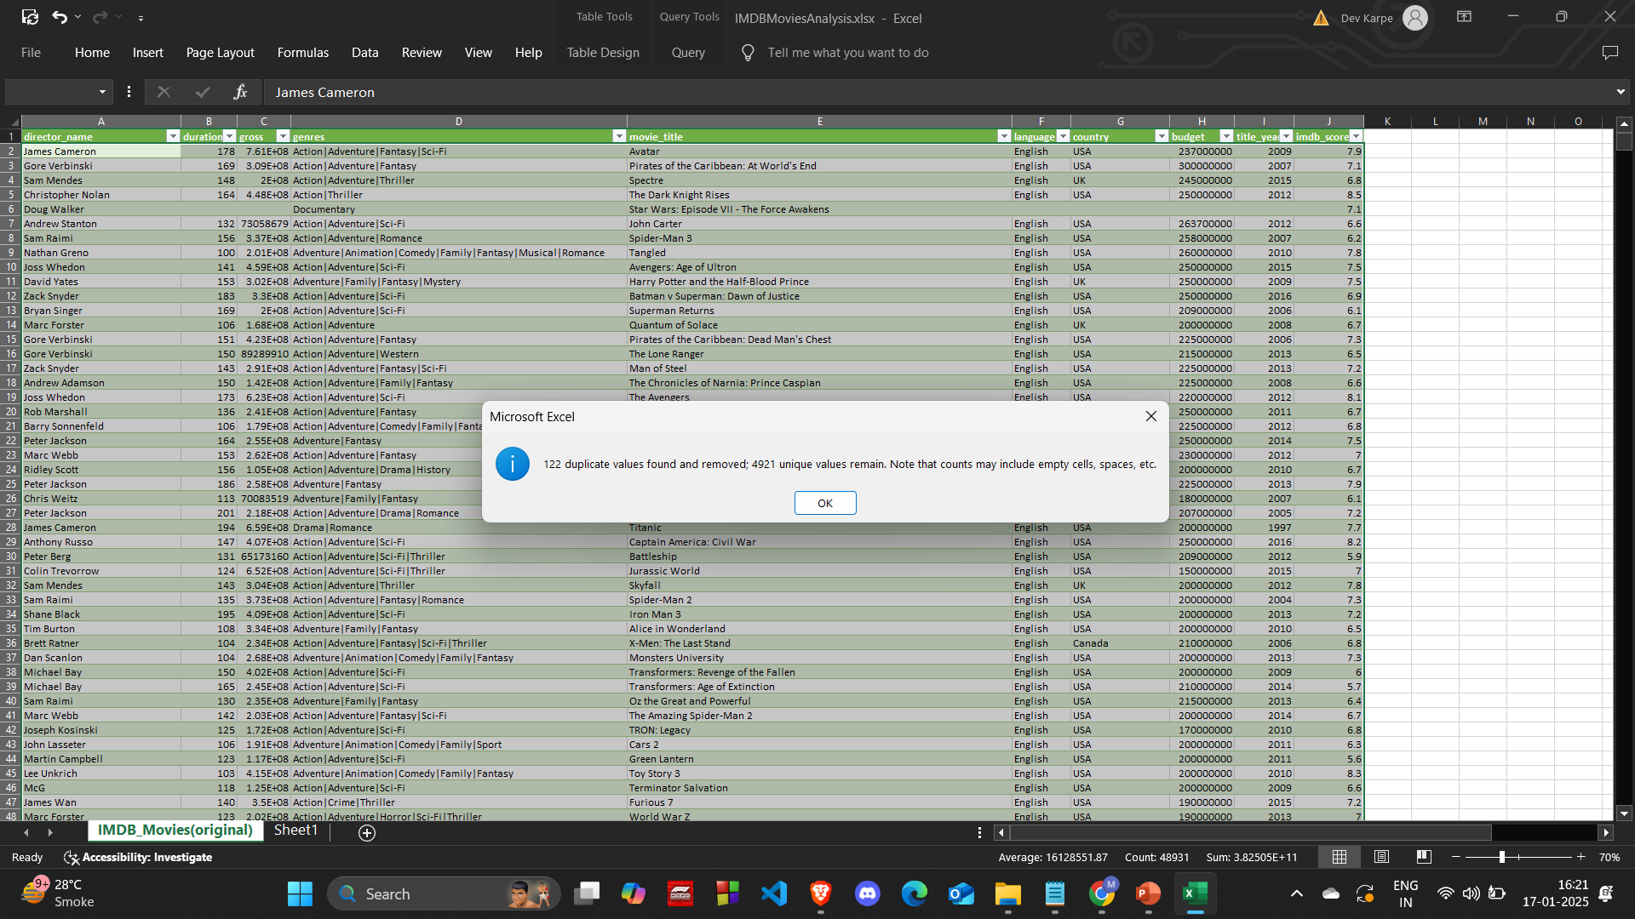
Insights
Data cleaning:
Firstly, I removed duplicate values

Slide 6
Next, the rows containing empty cells were deleted
I then changed the movie_title column to correct the spelling mistakes it had. This was done by creating a new column and using the substitute function.
Unnecessary columns were deleted. The columns color, director_facebook_likes, actor_3_facebook_likes, actor_2_name, actor_1_facebook_likes, actor_1_name, cast_total_facebook_likes, actor_3_name, facenumber_in_poster, plot_keywords, actor_2_facebook_likes, aspect_ratio, movie_imdb_link, content_rating were irrelevant and that’s why they were deleted.
The following columns are the relevant columns: director_name, duration, gross, genres, movie_title, language, country, budget, title_year, imdb_score.

Slide 7
Task A: Movie Genre Analysis: Analyze the distribution of movie genres and their impact on the IMDB score. Task: Determine the most common genres of movies in the dataset. Then, for each genre, calculate descriptive statistics (mean, median, mode, range, variance, standard deviation) of the IMDB scores.

Slide 8
Insights into Task A
Genre Analysis was done by first converting the genres column into multiple columns of different genres. This was done using text to column with delimiter as ‘|’. This allowed us to separate each genre.
Next, every unique genre was taken and using the COUNTIF function the number of movies for each genre were counted.
This was followed by using the AVERAGE, MODE, MEDIAN, MAX, MIN, VAR and STDEV functions to calculate the descriptive statistics.
I then used a column chart to show the most common movie genres.
The most common genres were Drama, Comedy, Thriller, Action, Romance.
The genres that weren’t that common were Documentary, Western and Film Noir

Slide 9
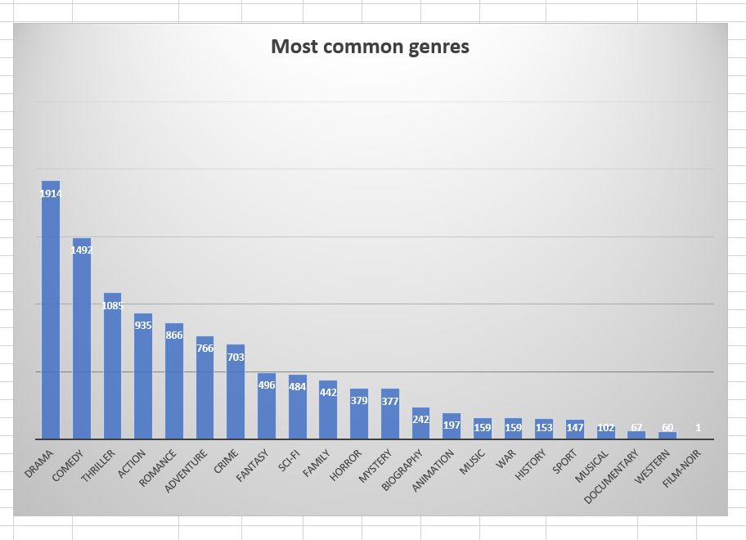
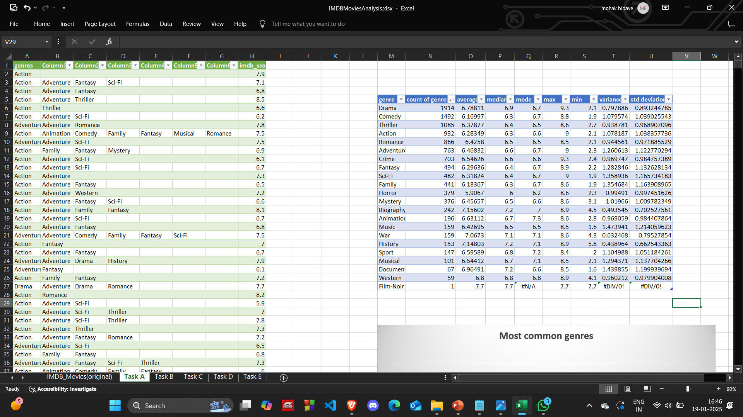
Formulas used:
=COUNTIF($A$2:$G$3790,M6)
=AVERAGE(IF(ISNUMBER(SEARCH(M6, $A$2:$G$3724)), $H$2:$H$3724))
=MEDIAN(IF($A$2:$G$3790=M6,$H$2:$H$3790))
=MODE(IF($A$2:$G$3790=M6,$H$2:$H$3790))
=MAX(IF($A$2:$G$3790=M6,$H$2:$H$3790))
=MIN(IF($A$2:$G$3790=M6,$H$2:$H$3790))
=VAR(IF($A$2:$G$3790=M6,$H$2:$H$3790))
=STDEV(IF($A$2:$G$3790=M6,$H$2:$H$3790))

Slide 10
Task B: Movie Duration Analysis: Analyze the distribution of movie durations and its impact on the IMDB score. Task: Analyze the distribution of movie durations and identify the relationship between movie duration and IMDB score.

Slide 11
Insights into Task B
This task was executed by applying the functions average, median and stdev on the duration and imdb_score columns.
A scatter plot was used to visualize the relationship between the movie duration and imdb score
From the visualization I understood that the upward slope of the trendline indicates that the movies with a longer duration tend to have a slightly higher imdb rating.
The scatter plot also suggests that movies within the duration of 90-150 minutes form a dense cluster indicating that most movies fall within this range. These movies receive a mid range imdb score.

Slide 12
The formulas I used were:
=AVERAGE(A2:A3790)
=MEDIAN(A2:A3790)
=STDEV(A2:A3790)
mean | median | std deviation
109.8029 | 105 | 22.75721064

Slide 13
Task C: Language Analysis: Situation: Examine the distribution of movies based on their language. Task: Determine the most common languages used in movies and analyze their impact on the IMDB score using descriptive statistics.

Slide 14
Insights into Task C
I used the columns movie_title, language and imdb_score.
By removing the duplicates from the language column I got a list of all the unique languages.
Next I applied formulas like COUNTIF, AVERAGEIF, MEDIAN, STDEV to get the descriptive statistics.
I learnt that English was the most popular language for movies. It had a count of 3609. The average imdb score for English movies is 6.42. This is lower than many other languages and a reason for that could be due to the wide variety of movies differing in quality.
English is followed by French and Spanish as the second and third most common languages.
The languages having smaller sample sizes indicate that the few movies in these languages tend to receive high ratings. This could be because of the niche and high-quality films.
Italian and Hindi movies have a broader range of ratings. this shows that their movies can be either of good quality or poor quality.
Languages like Danish (8.1), Portuguese (8), and Persian (8.4) have high median ratings, suggesting that even the lower-rated movies in these categories are well-received
Languages with only one movie have no median hence showing an error and no standard deviation.

Slide 15
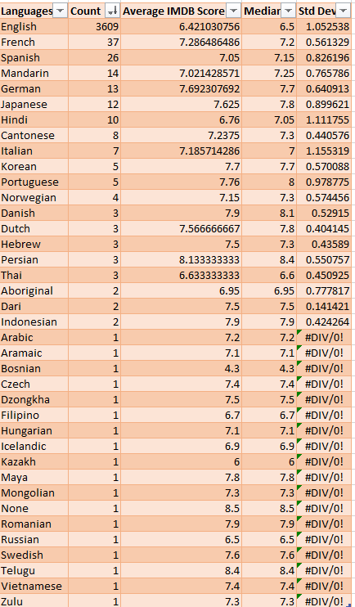
Formulas used:
=COUNTIF($A$2:$B$3790,E7)
=AVERAGEIF($B$2:$C$3790,E7,$C$2:$C$3790)
=MEDIAN(IF($B$2:$C$3790=E7,$C$2:$C$3790))
=STDEV(IF($B$2:$C$3790=E7,$C$2:$C$3790))

Slide 16
Task D: Director Analysis: Influence of directors on movie ratings. Task: Identify the top directors based on their average IMDB score and analyze their contribution to the success of movies using percentile calculations.

Slide 17
Insights into Task D:
The directors column was taken and duplicates were removed to get a new column of all the unique director names.
Next, I calculated the average of the imdb score for each director by using the AVERAGEIF formula.
Using a pivot table I’ve displayed the average imdb score of the top 10 directors.
The percentile function gave a value of 7.5 which indicated that the directors with a score above 7.5 are the top directors.
I then labelled the top directors with the IF function.
A pie chart was made to represent the top 10 directors. This was done by using the pivot table.

Slide 18
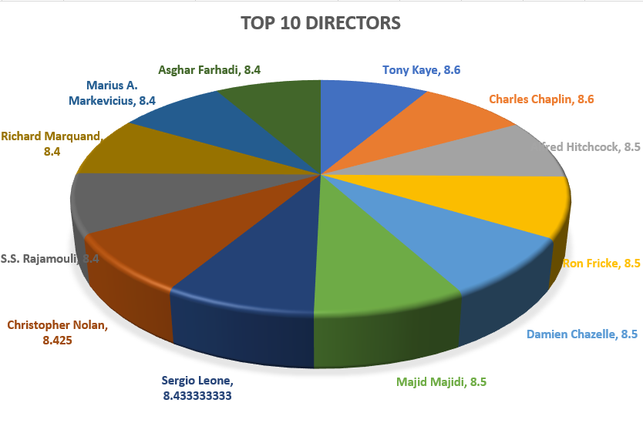
Formulas used:
=AVERAGEIF($A:$A,D2,$B:$B)
=PERCENTILE(E:E,0.9)
=IF(E2>7.5,"Top","")
percentile
7.5

Slide 19
TASK E: Budget Analysis: Explore the relationship between movie budgets and their financial success. Task: Analyze the correlation between movie budgets and gross earnings, and identify the movies with the highest profit margin.

Slide 20
Insights into Task E:
Profit was calculated by subtracting gross from the budget.
The top 10 movies with the most profit are displayed using a pivot table.
CORREL function was used to calculate the correlation coefficient between gross and budget.
A correlation of 0.09664 suggests that there is a very weak relationship between a movies budget and its gross earnings.
This made me understand that budget alone doesn’t drive success and that gross earnings depend on various factors like marketing, audience appeal, star power and release timing which may overshadow the impact of the budget.
The movie with the most profit was Avatar. It had a profit of $52,35,05,847.

Slide 21
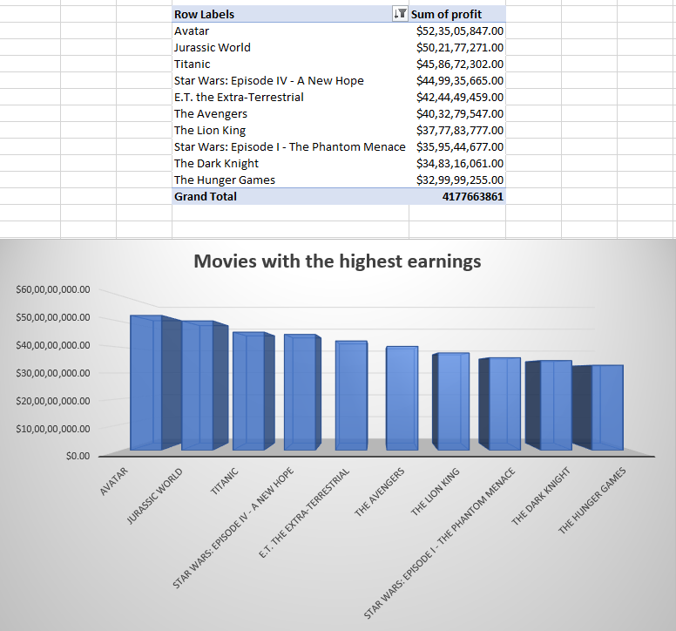
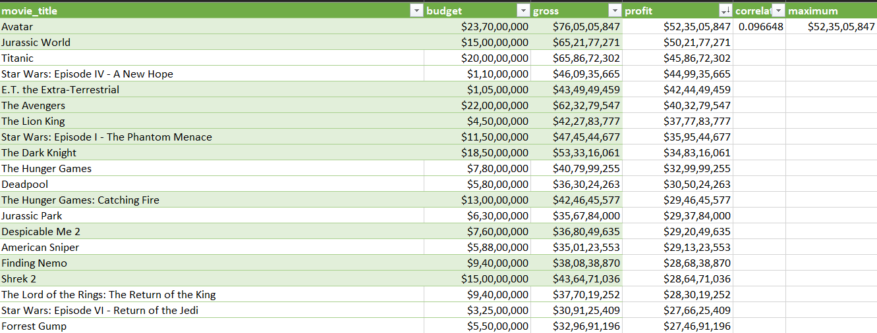
Formulas used:
Gross-budget (C2-B2)
=CORREL(B:B,C:C)
=MAX(D:D)

Slide 22
CONCLUSION
Through this project I was able to gain hands-on learning experience and improve my skills in data analysis, statistical methods and visualization tools. My knowledge and understanding of how data can tell a story and provide meaningful insights has also deepened.

Slide 23
Links
Excel Sheet link:
https://docs.google.com/spreadsheets/d/1MwRynHWBKfa9MBIrnVZnLzuIIYcYagRF/edit?usp=drive_link&ouid=109524556463170667809&rtpof=true&sd=true

